Slide 1

Cornell
Notes

Slide 2

The Hidden Curriculum
Quickwrite Questions:
How did you learn the skill of note taking?
How did this skill contribute to your success?

Slide 3

Why take notes?
Cornell note taking stimulates critical thinking skills.
Note taking helps students remember what is said in class.
A good set of notes can help students work on assignments and prepare for tests outside of the classroom.

Slide 4
Why take notes?
Good notes allow students to help each other problem solve.
Good Notes help students organize and process data and information.
Helps student recall by getting them to process their notes 3 times.
Writing is a great tool for learning!

Slide 5

History of Cornell Notes
Developed in 1949 at Cornell University by Walter Pauk.
Designed in response to frustration over student test scores.
Meant to be easily used as a test study guide.
Adopted by most major law schools as the preferred note taking method.

Slide 6
First & Last Name
Class Title
Period
Date
Topic
Questions,
Subtitles,
Headings,
Etc.
Class Notes
2 1/2”
3 to 4 sentence summary across
the bottom of the last page of the day’s notes

Slide 7
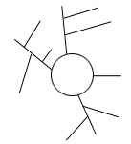
Subject:
Why take Cornell notes?
Date: 11/20/01
P
R
O
C
E
S
S
M
a
i
n
I
d
e
a
s
(
i
P
R
O
C
E
S
S
M
a
i
n
p
u
t
)
n
I
d
e
a
s
(
i
n
p
u
t
)
(
o
u
t
p
u
t
)
(
o
u
t
p
u
t
)
Can
be used to provide an outline of chapter or lecture.
How can
Organized by main ideas and details.
Cornell notes
Can be as detailed as necessary.
Sequential
help me
--
take notes as they are given by instructor or
organize my
text in an orderly fashion.
ideas?
After class, write a summary of what you learned to
clarify and reinforce learning and to assist retention.
Can be used as study tool:
Which side for
1. Define terms or explain concepts listed on left side.
diagrams?
2. Identify the concept or term on the right side.
Why use
Can be used to provide a "big picture" of the chapter or
concept maps?
lecture.
Organized by main ideas and sub-topics
Limited in how much detail you can represent.
Simultaneous
-
you can use this method for instructors
who jump around from topic to topic.
After class, you can add questions to the left side
What are the
Can be used as a study tool
--
to get a quick overview
benefits to me?
and to determine whether you need more information or
need to concentrate your study on specific topics.

Slide 8
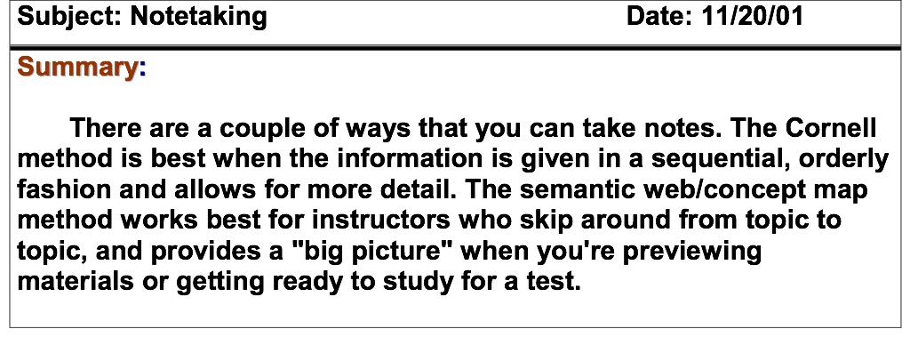
Summary is added at the end of ALL note pages on the subject (not at the end of each page)
Summary added AFTER questions
are finished

Slide 9
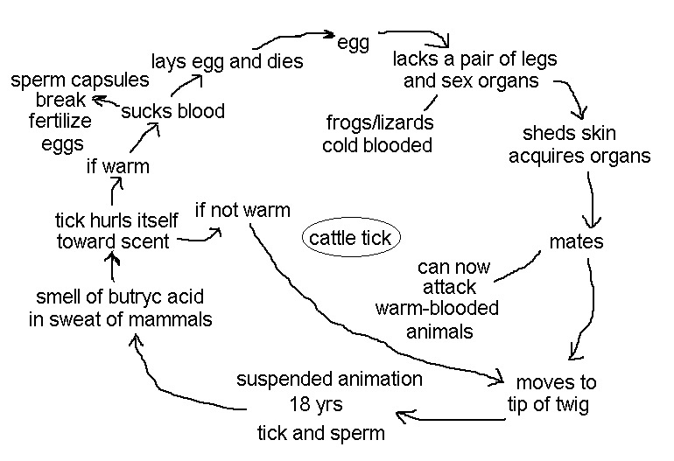
Example
(Questions about it )
(Diagram copied
during lecture)
How do the ticks find the cattle?
Why don’t the ticks usually kill their host?
How could tick infestations in cattle impact humans?

Slide 10
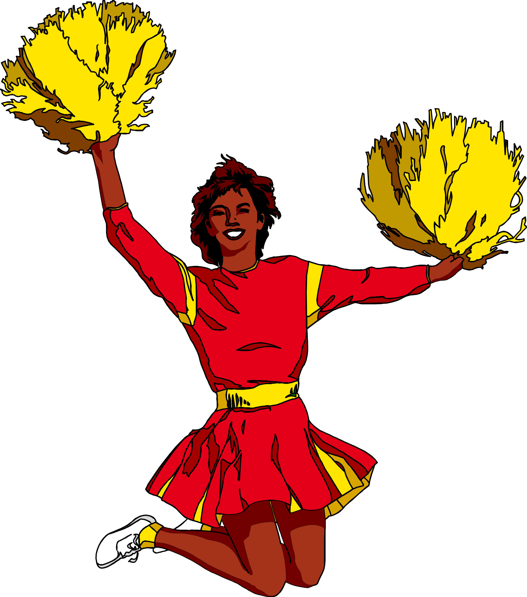
Practice Time
Let’s get out a sheet of Cornell note paper and get ready to practice the skill.

Slide 11

Assignment & Instructions
In the large, right hand column, take notes like you normally would.
You may use any style of note-taking you wish:
  outline format,
  narrative format,
  symbols,
  short hand, etc.

Slide 12
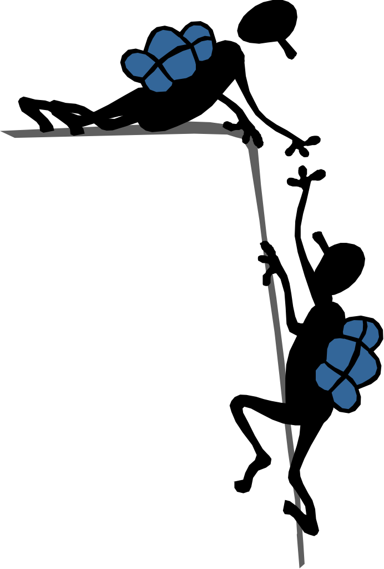
Assignment & Instructions
Compare notes with a partner.
Talk about what you wrote and why. Look for gaps & missed info.
Both partners should feel free to add to their notes.

Slide 13

Assignment & Instructions
With your partner(s), create questions in the left hand column.
These questions should elicit critical thinking skills.
  Levels 3 through 6 in Bloom’s Taxonomy.

Slide 14
Brief Review of Bloom's Taxonomy
1. KNOWLEDGE: recalling information
2. COMPREHENSION: understanding meaning
3. APPLICATION: using learning in new situations
4. ANALYSIS: ability to see parts & relationships
5. SYNTHESIS: Use parts to create a new whole
6. EVALUATION: judgment based on criteria

Slide 15
Assignment & Instructions
Your questions should reflect:
Info you don’t understand or want to discuss with your teacher/tutor.
Info you think would go good on an essay test.
Gaps in your notes.

Slide 16
Assignment & Instructions
On your own, in the space provided at the bottom of the page, complete a 3 or 4 sentence summary of what you wrote in your notes.
(the summary…)

Slide 17
What goes where?
Questions,
subtitles,
etc. go here,
in the left
hand column.
Remember,
we want
higher level
critical
thinking
questions.
Don’t forget the heading:
Name, Class, Period, Date, Topic
Notes go here, in the
large right hand column.
A 3 to 4 sentence summary down there on the bottom of the last page of notes

Slide 18

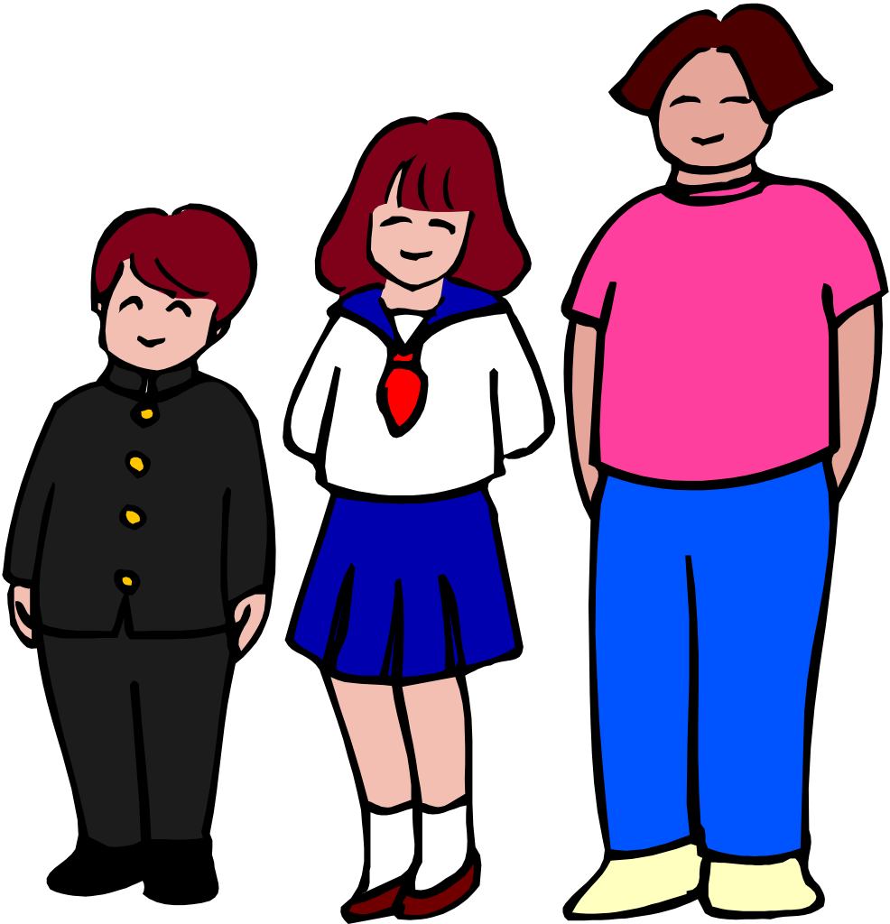
In the right sleeve of your packet:
Basic Cornell Notes Instruction Sheet
Progression Samples

Slide 19
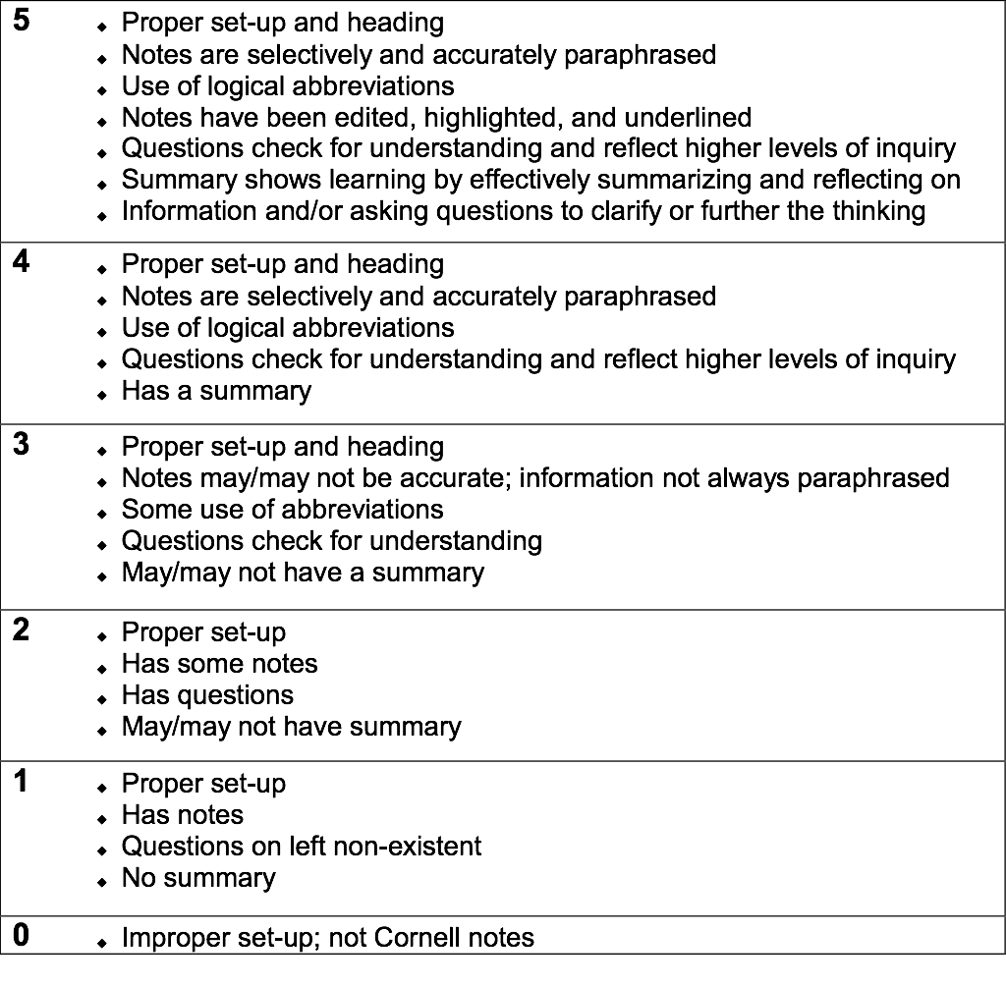
Grading Rubric

Slide 20






SQ4R-Writing to Learn
(Overview: quickly scan)
(Establish a purpose)
(to answer questions)
(answers to questions with the book closed)
(Take notes!)
(at short intervals)

Slide 21
Learning Logs
A writing technique to help focus
on what you are learning in class.
Writing in your learning log is a
great way to use writing as a
process of discovery and for
clarification of ideas.

Slide 22
Note Taking Tips
Speaker says: “Hippocrates, a
Greek who is considered to be the
Father of modern medicine, was
Born on the island of Cos in
460 B.C.”
Notes say: “Hippocrates (Gr.)
Father of med. B. Cos 460BC”

Slide 23

Designed by
Paul Bullock
Senior Program Specialist
&
Anne Maben
AP Science Coach

